Slide 1
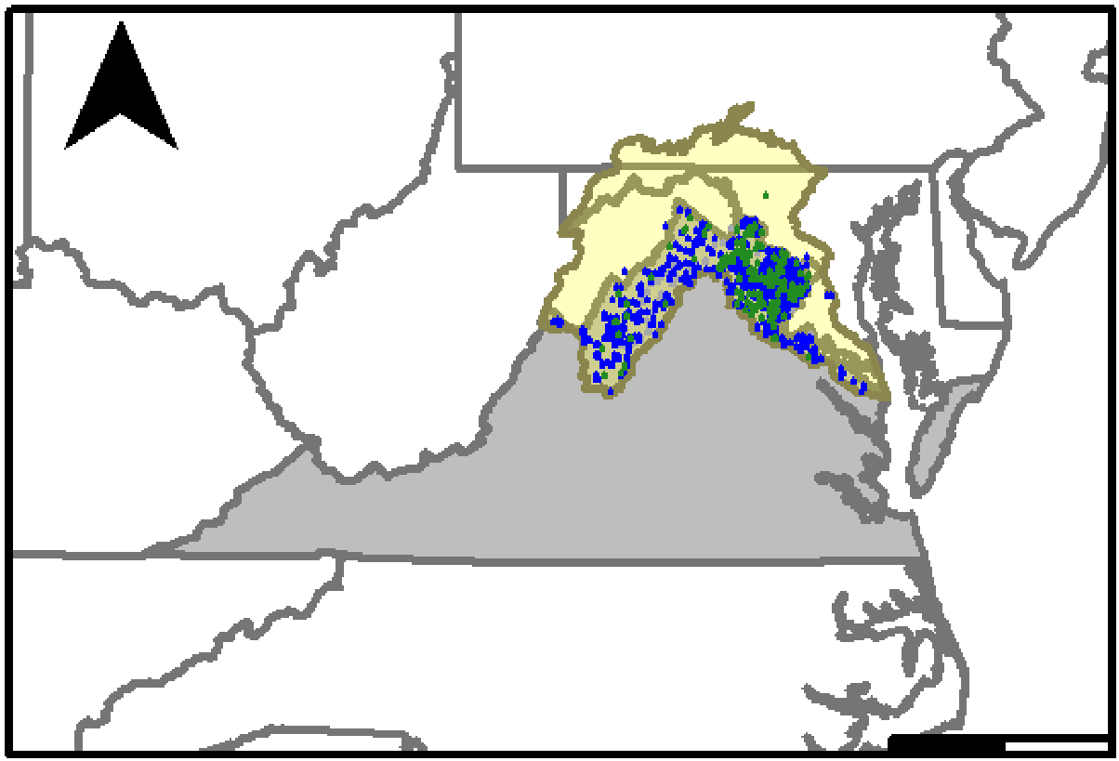
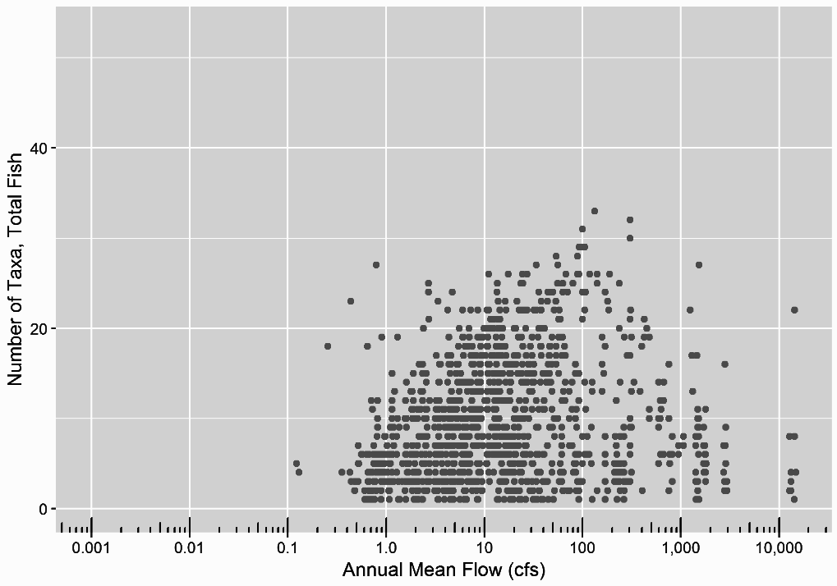
From Habitat to Richness
Limited habitat datasets available (site specific)
Plentiful species richness data (statewide)
Ecological Limit Functions (ELF) describe relationship between flow and richness (bio-diversity)
Notes:
Specifically mention automation using R
Data visualization component - helping to make sense of large, complex, existing datasets

Slide 2
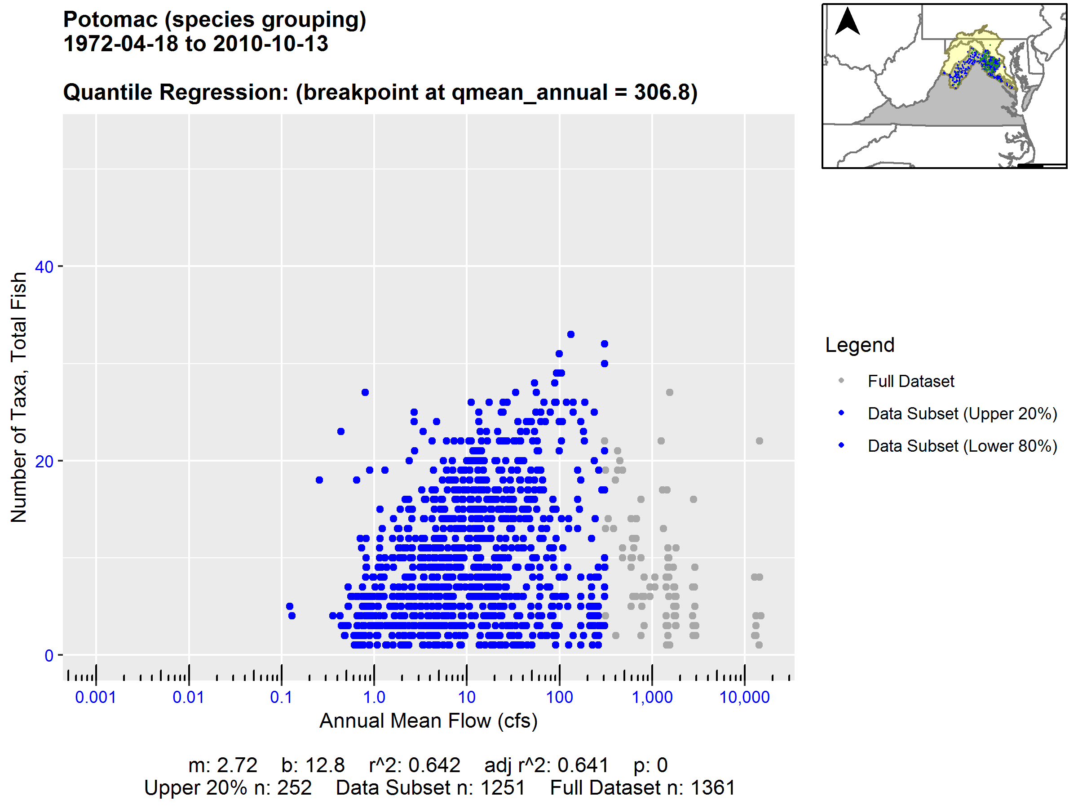


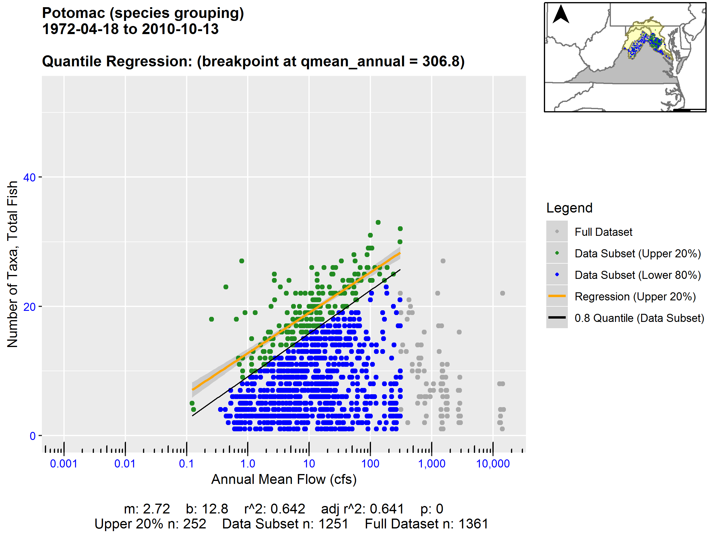
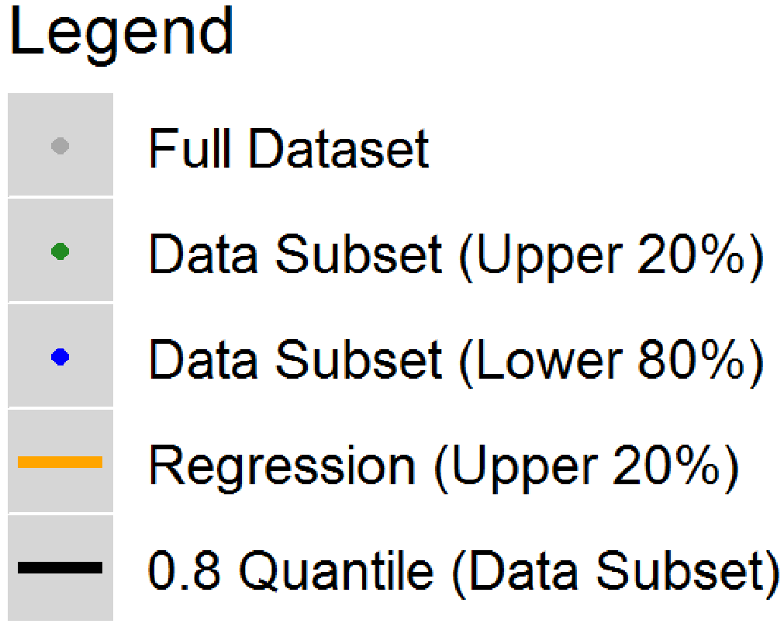
From Habitat to Richness
Limited habitat datasets available (site specific)
Plentiful species richness data (statewide)
Ecological Limit Functions (ELF) describe relationship between flow and richness (bio-diversity)
Upper Quantile Data
Upper Quantile Data
Ecological Limit Function (ELF)
Statistics
Breakpoint
Statistics

Slide 3
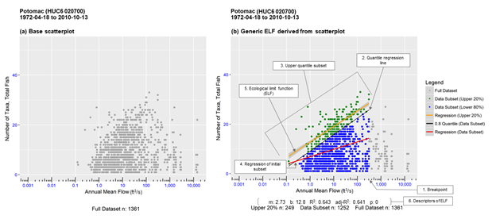

Slide 4
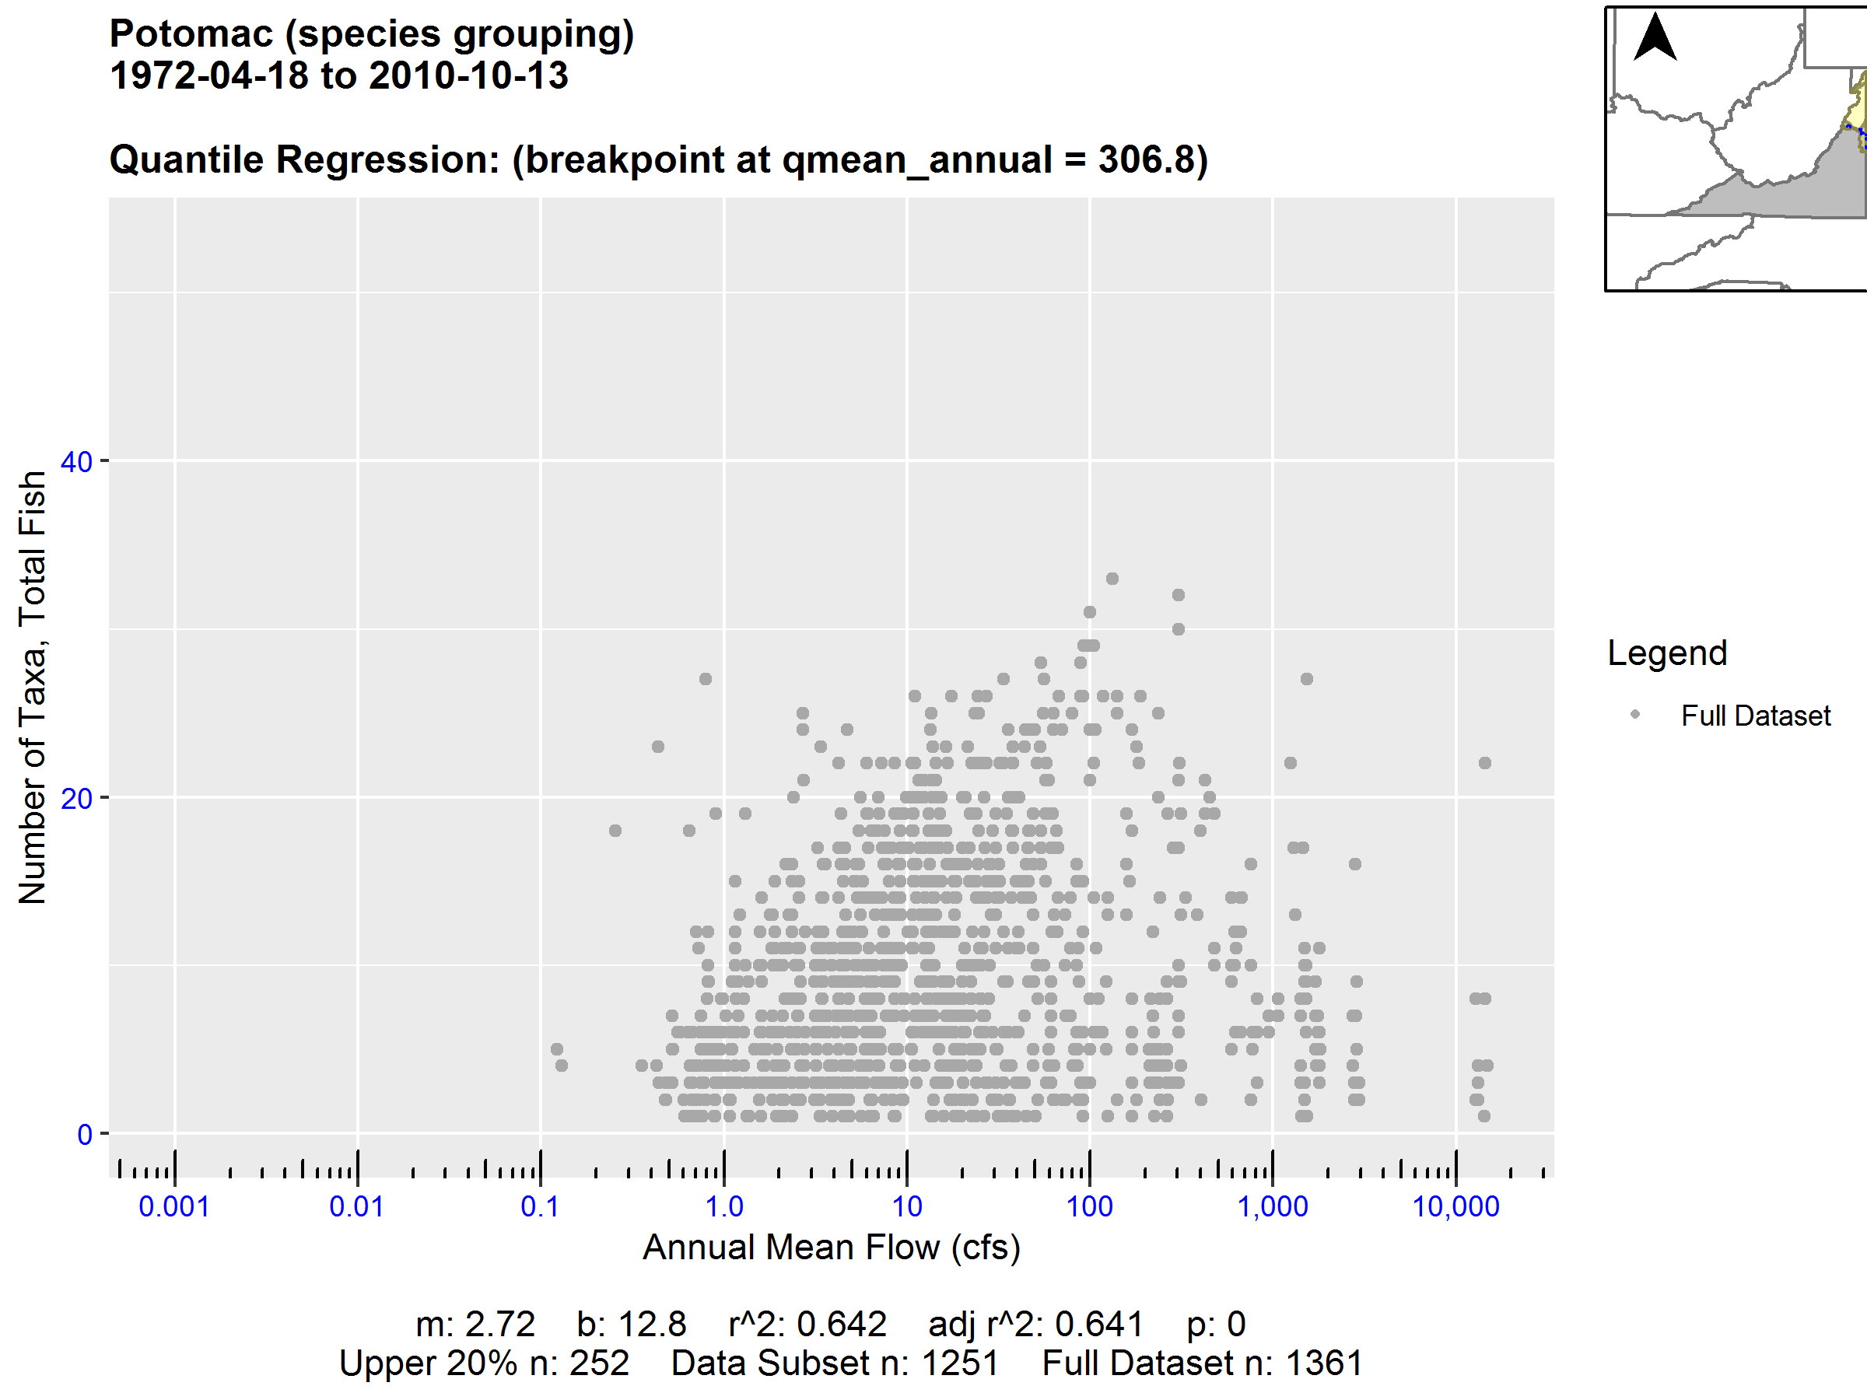
Upper Quantile Subset
Ecological Limit Function (ELF)
Quantile Regression
Line
Breakpoint
Statistics

Slide 5
Upper Quantile Subset
Ecological Limit Function (ELF)
Quantile Regression
Line
Breakpoint
Statistics

Slide 6
b) ELF Derived From Base Plot
a) Base Plot
Upper Quantile Subset
Ecological Limit Function (ELF)
Quantile Regression
Line
Breakpoint
Statistics

Slide 7
a) Base Plot
b) Ecological Limit Function
Upper Quantile Subset
Ecological Limit Function (ELF)
Quantile Regression
Line
Breakpoint
Statistics

Slide 8
a) Base Plot
b) Ecological Limit Function
3. Upper Quantile Subset
4. Ecological Limit Function (ELF)
2. Quantile Regression
Line
1. Breakpoint
5. Statistics

Slide 9
a) Base Plot
b) Ecological Limit Function
3. Upper Quantile Subset
4. Ecological Limit Function (ELF)
2. Quantile Regression
Line
1. Breakpoint
5. Statistics

Slide 11
3. Upper Subset

